Slide 1
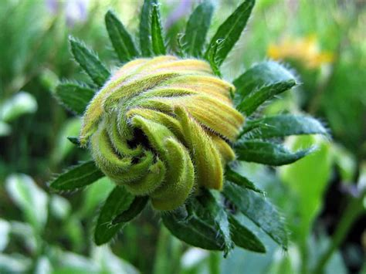
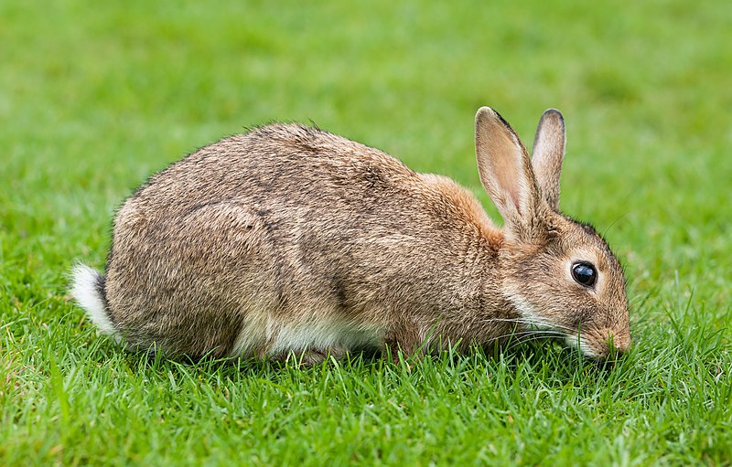
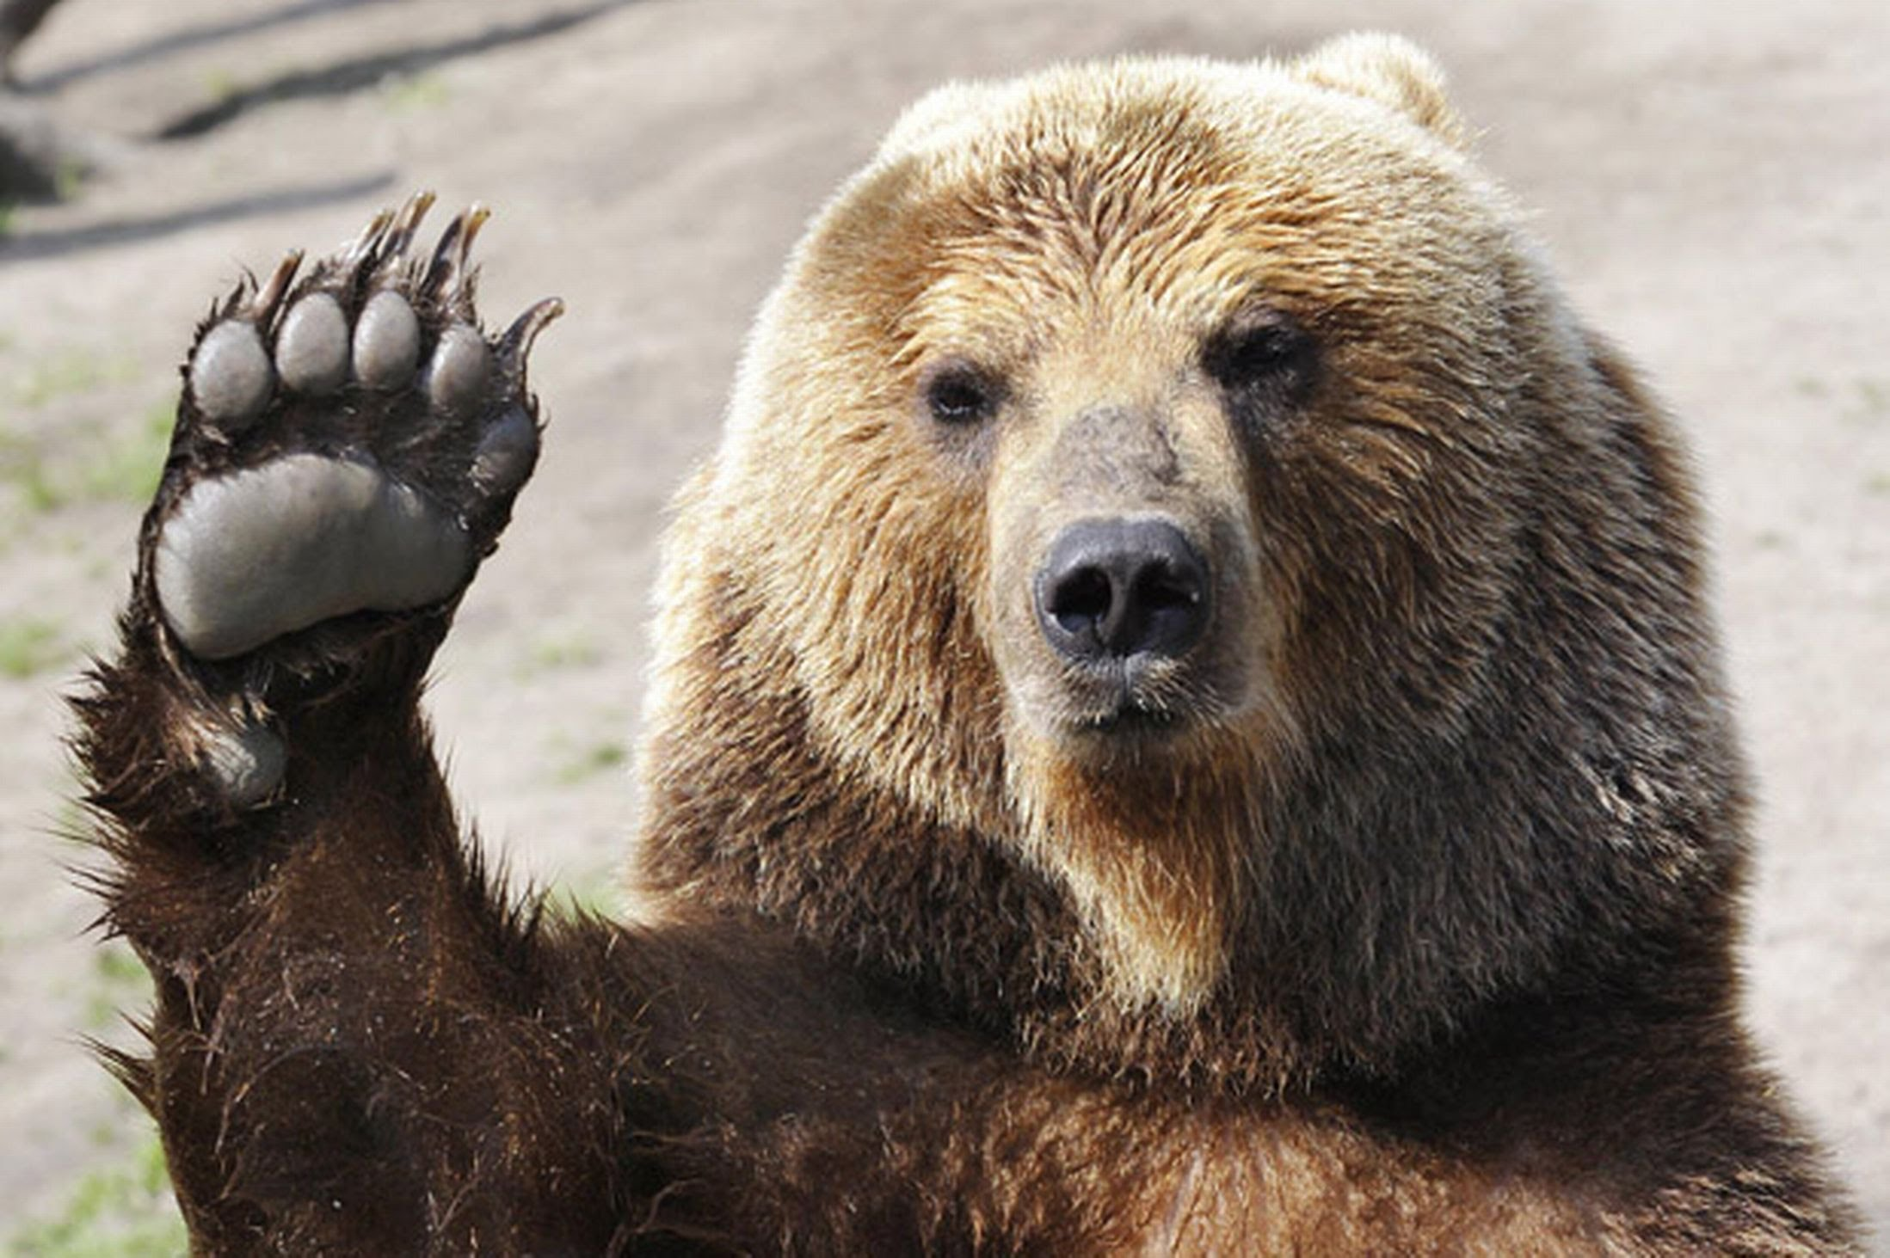
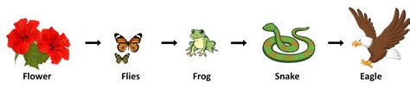
Food Chains – Page 1
In the following passage, underline or highlight all the key-words and information. Then, answer the questions on the back
A food chain is a way to show how living things in an ecosystem get their energy by eating other living things. It all starts with plants, which are able to make their own food using sunlight, water, and carbon dioxide. Plants are like the "base" of the food chain, providing energy for other living things.
Next in the food chain are herbivores, which are animals that eat only plants. Herbivores get their energy by eating the plants. Examples of herbivores include cows, rabbits, and deer.
Carnivores are animals that eat only other animals. They are the next in the food chain after herbivores. Examples of carnivores include lions, wolves, and snakes. Carnivores get their energy by hunting and eating other animals.
Finally, there are omnivores, which eat both plants and animals. Examples of omnivores include humans, bears, and raccoons. Omnivores are like a mix of herbivores and carnivores because they eat both plants and animals.
In summary, a food chain shows how living things in an ecosystem get their energy by eating other living things. It all starts with plants, which provide energy for herbivores. Herbivores then provide energy for carnivores, which in turn provide energy for omnivores.

Slide 2
Food Chains – Page 2
What is a food chain?
______________________________________________________________________
What are the three things plants use to make food?
__________________________________________________________
__________________________________________________________
__________________________________________________________
What is a herbivore?
______________________________________________________________________
What is a carnivore?
______________________________________________________________________
What is an omnivore?
______________________________________________________________________
What is an example of each type of eater?
Herbivore: __________________________________________________________
Carnivore: __________________________________________________________
Omnivore: __________________________________________________________
Why are plants important in a food chain?
______________________________________________________________________
Can you give an example of a food chain?
______________________________________________________________________

